Slide 1
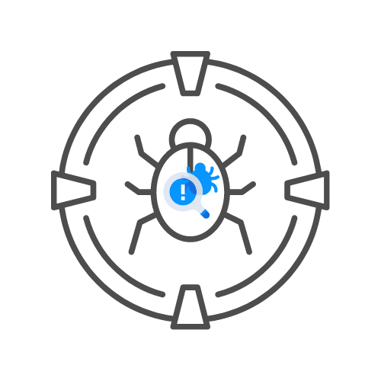
XPATH INJECTION
⌛ 60 min
WHAT IN HEAVEN’S NAME IS XPATH?
DAY 05

Slide 2
Agenda
WHAT IS XPATH ?
WHY IT CAN BE DANGEROUS ?
HOW TO TEST FOR IT ?
LABS

Slide 3
WHAT IS XPATH?
XML STRUCTURED DOCUMENT
WE WANT TO QUERY A NODE
WE CAN WORK WITH XML LIBRARIES
WE CAN ALSO USE “XPATH”
FOR EXAMPLE, THE CHROME DEVELOPER TOOLS ALLOW XPATH

Slide 4
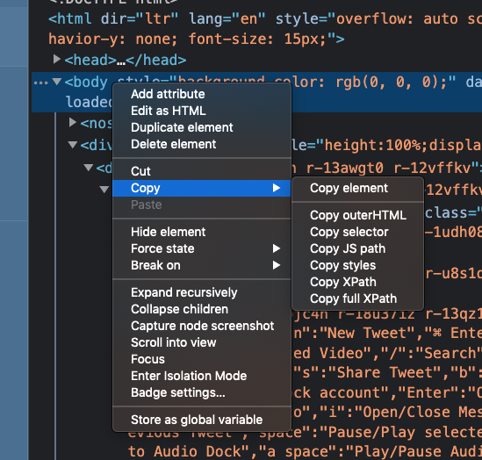
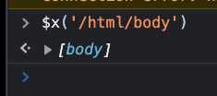
WHAT IS XPATH?

Slide 5
WHAT IS XPATH?
CAN BE USEFUL FOR TEST AUTOMATION
IF IT IS USED TO QUERY AN XML FILE, THERE IS NO ACL ON XML FILES
WE CAN QUERY ANY NODE
USER INPUT IS DANGEROUS

Slide 6
WHY IT CAN BE DANGEROUS
USER CAN QUERY ANY NODE
EVEN THE ONES THEY SHOULD NOT
IF USER INPUT IS ALLOWED, THIS CAN BE DANGEROUS

Slide 7
HOW TO TEST FOR IT
https://owasp.org/www-project-web-security-testing-guide/latest/4-web_application_security_testing/07-input_validation_testing/09-testing_for_xpath_injection
ANALYSE XPATH INTERACTION WITH XML FILE
IMAGINE XML STRUCTURE
CRAFT ATTACK STRING

Slide 8
HOW TO TEST FOR IT
STRING(//USER[USERNAME/TEXT()='GANDALF' AND PASSWORD/TEXT()='!C3']/ACCOUNT/TEXT())
🎯USERNAME: ' OR '1' = ‘1
🎯PASSWORD: ' OR '1' = ‘1
STRING(//USER[USERNAME/TEXT()='' OR '1' = '1' AND PASSWORD/TEXT()='' OR '1' = '1']/ACCOUNT/TEXT())

Slide 9
LABS 🥼
🎯HTTPS://HACKXPERT.COM/LABS/XPATH_INJECTION/

