Slide 1
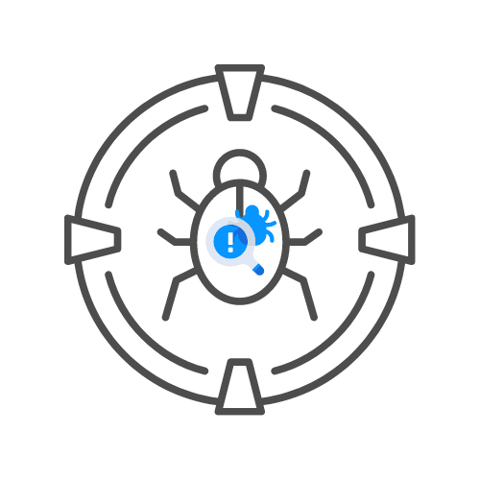
The parts of a test plan
⌛ 60 min
DAY 05

Slide 2
What’s included?
Version headers
Introduction
Scope
Quality objective
The phases of a pentest
Roles and responsibilities
Assumptions for test execution (entry criteria)
Constraints for testing
When testing is done (deliverables)
Definitions
Test methodology

Slide 3
What’s included?
Test deliverables
How and where to track defects (optional)
Test environment

Slide 4
Version headers
Just a small table to keep track of the versions and changes
Include version number, author, reviewer, changes and reviewer comments
Make sure to have every version reviewed

Slide 5
Introduction
Talk about the project, the company and the reason of the test
Don’t make this too complicated, the rest will follow
Ex:
The XSS Rat has a network that is protected by several security mechanisms. This test will attempt to verify these and test any existing issue using the OWASP WSTG and OWASP top 10.

Slide 6
Scope
Include in scope, all domains, ips and if needed, ports (sometimes you might be limited to certain ports)
Scopes can also contain 1 feature alone instead of complete apps/networks
Define scope well and check with customer
Include out of scope, for example third party systems
Ex.
We have an API in scope that lives on 127.0.0.1:3908
We have a website in scope on 127.0.0.1:80 and 127.0.0.1:443 (for websites, always check port 80 as well if allowed)

Slide 7
Quality objectives
We need to be clear about what we are testing for
Can be compliance for standards for example
Do we want to focus on high Impact issues or approaching like a real hacker with every defense enabled?
Ex.
With this vulernarbility scan we want to verify OWASP top 10 and SANS CWE top 25 compliance

Slide 8
Phases of a pentest
Enumeration
Exploration
Exploitation
Reporting
First you try to verify scope, then you look for potential issue, next you try to exploit them and report on them. This is usually the same-ish for every test.

Slide 9
Roles and responsibilities
Very important
Contains contact info of key employees
Both on client and attackers side
Must contain emergency contact if production testing is involved

Slide 10
Assumptions for testing
Sometimes, we have to sign an NDA
Sometimes we have to have a VPN
Sometimes we have to have our ip’s whitelisted
Sometimes we need to have accounts
...
Note down all of these!

Slide 11
Constraints for testing
Note down when testing will end
Make sure to include emergency scenario’s
For example, if the environment for testing is down
Or if the accounts get blocked because of the attacks
Try to note down mitigations

Slide 12
When testing is done
Indicate either a timeframe or conditions for ending the test
For example if the system has been infiltrated, all tests end
IMPORTANT! Company does not get paid until everything is done
Usually includes report delivered and debriefing done

Slide 13
When testing is done
Indicate either a timeframe or conditions for ending the test
For example if the system has been infiltrated, all tests end
IMPORTANT! Company does not get paid until everything is done
Usually includes report delivered and debriefing done

Slide 14
Testing methodology
Explain more about the tests you want to do and in what way
Explain your methodology but also your way of keeping track of the progress
Refer to checklists and guides such as OWASP WSTG and explain where you diverge
Sometimes you may need to combine server things such as API, network and web or even mobile

Slide 15
Test deliverables
Contract
NDA’s
Test plan
Test report
Debrief report

Slide 16
Defect tracking
Sometimes bug trackers are used
I.E. Jira
Note down where and how you will track these bugs

Slide 17
Test enviornment
Describe the test network/webapp
Is it sandbox? Production?
How closely related is it production?

